Slide 1

Big Data Analysis of
New York City Taxi Trip Record Data
Team:
Akshdeep Singh Rajawat, Dhvani Patel, Prasenjeet Paul, Rajat Maheshwari, Rishabh Mehta

Slide 2

Domain and Data Selection
Open Data Registry: Data of trips taken by taxis and for-hire vehicles in New York City (https://registry.opendata.aws/nyc-tlc-trip-records-pds/)

Slide 3
Business Problem And Opportunity
New York City has millions of taxi trips taken every month. The yellow and green taxi trip records include fields capturing pick-up and drop-off dates/times, pick-up and drop-off locations, trip distances, itemized fares, rate types, payment types, and driver-reported passenger counts.
Business opportunity /objective here is to maximize the profits of taxi drivers by analyzing the data.

Slide 4
Research Objectives And Questions
1. Which days have the highest amount of fare?
2. How many passengers per ride gets more fare?
3. Which time of the day do passengers tip the most?
4. Which areas have the highest number of riders?
5. Which area passengers tip the most?
6. Which trip areas can help drivers generate the most amount of revenue?

Slide 5
Dataset
The dataset includes trip records from all trips completed in yellow taxis in NYC in January. Records include fields capturing pick-up and drop-off dates/times, pick-up and drop-off locations, trip distances,
itemized fares, rate types, payment types, and driver-reported passenger counts.
Tool Used for Data Analysis: Amazon QuickSight

Slide 6
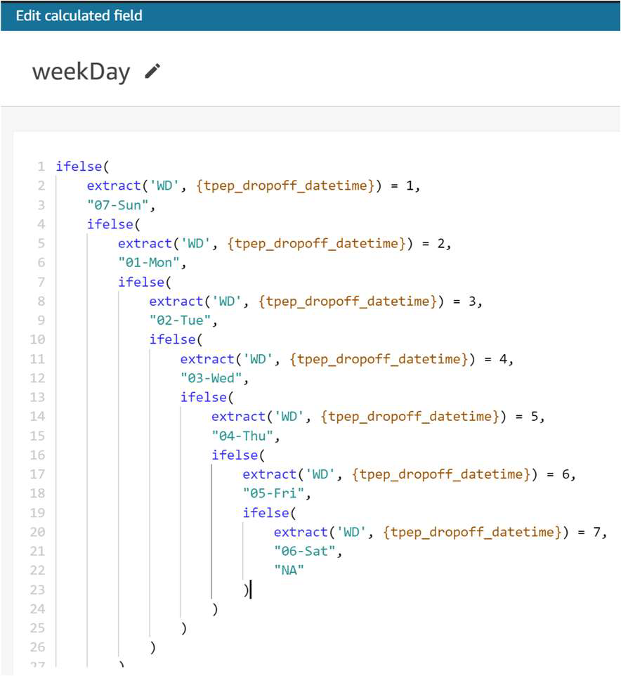
Data Preparation
1. The data is cleaned to remove null values.
2. In the pre-processing step, a calculated field is added to the dataset named `weekDay` which calculates the week of the trip date.

Slide 7
Data Preparation
1. The data is cleaned to remove null values.
2. In the pre-processing step, a calculated field is added to the dataset named `weekDay` which calculates the week of the trip date.

Slide 8
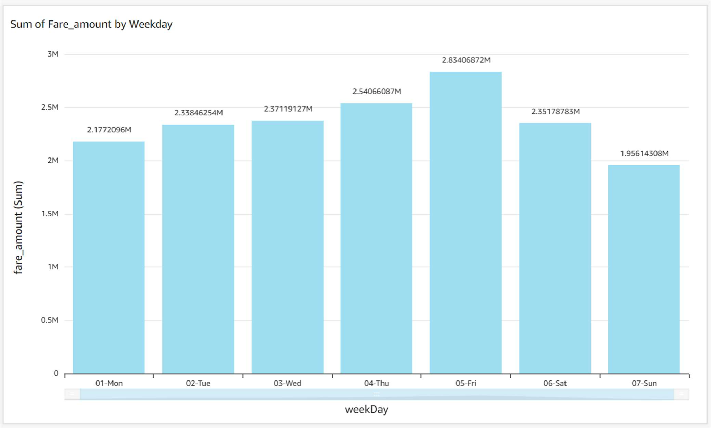
Data Analysis
Analysis 1:
This vertical bar chart shows the correlation between total fare on each day of the week. It is observed
that:
1. Maximum collection happened on Friday ($2.8 Million).
2. Minimum happened on Sunday with $1.95 Million.

Slide 9
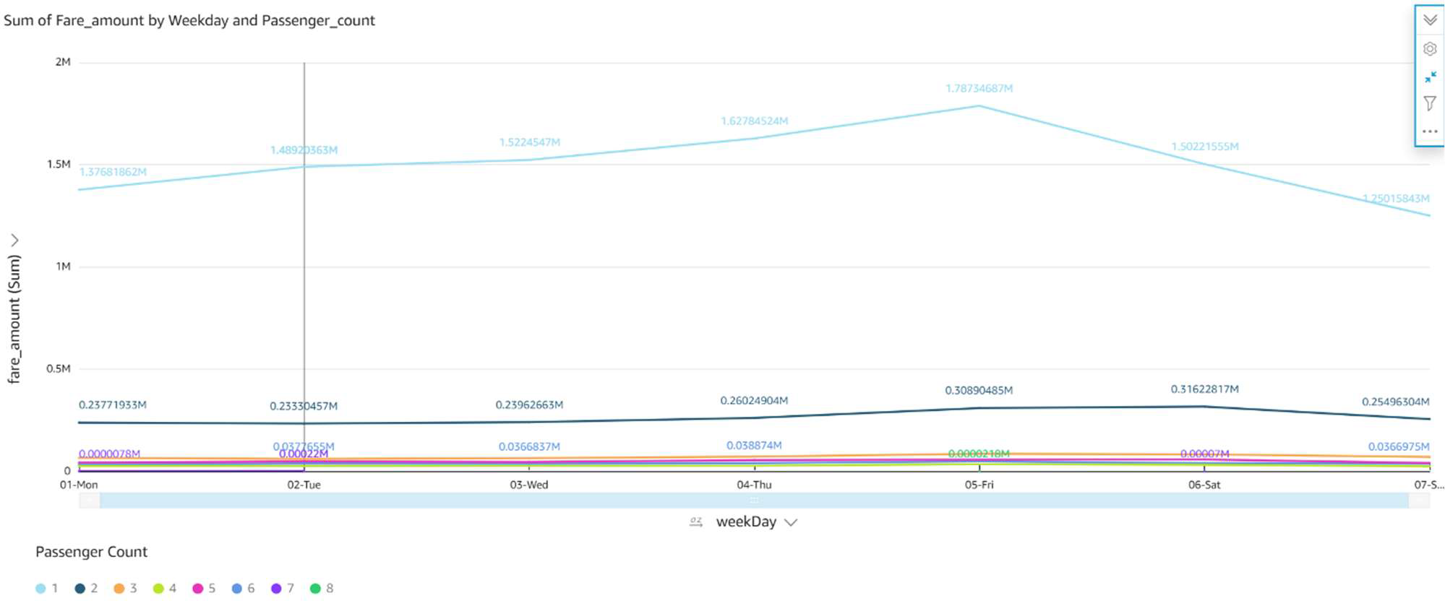
Data Analysis
Analysis 2:
This Line Chart shows the total fare amount on each weekday grouped by the passenger count.
1. Passengers traveling alone contribute more to the total fare amount, and Friday is seen to have
the highest collection.
2. Passengers traveling in group of 2 contribute the second highest to the total fare amount.

Slide 10
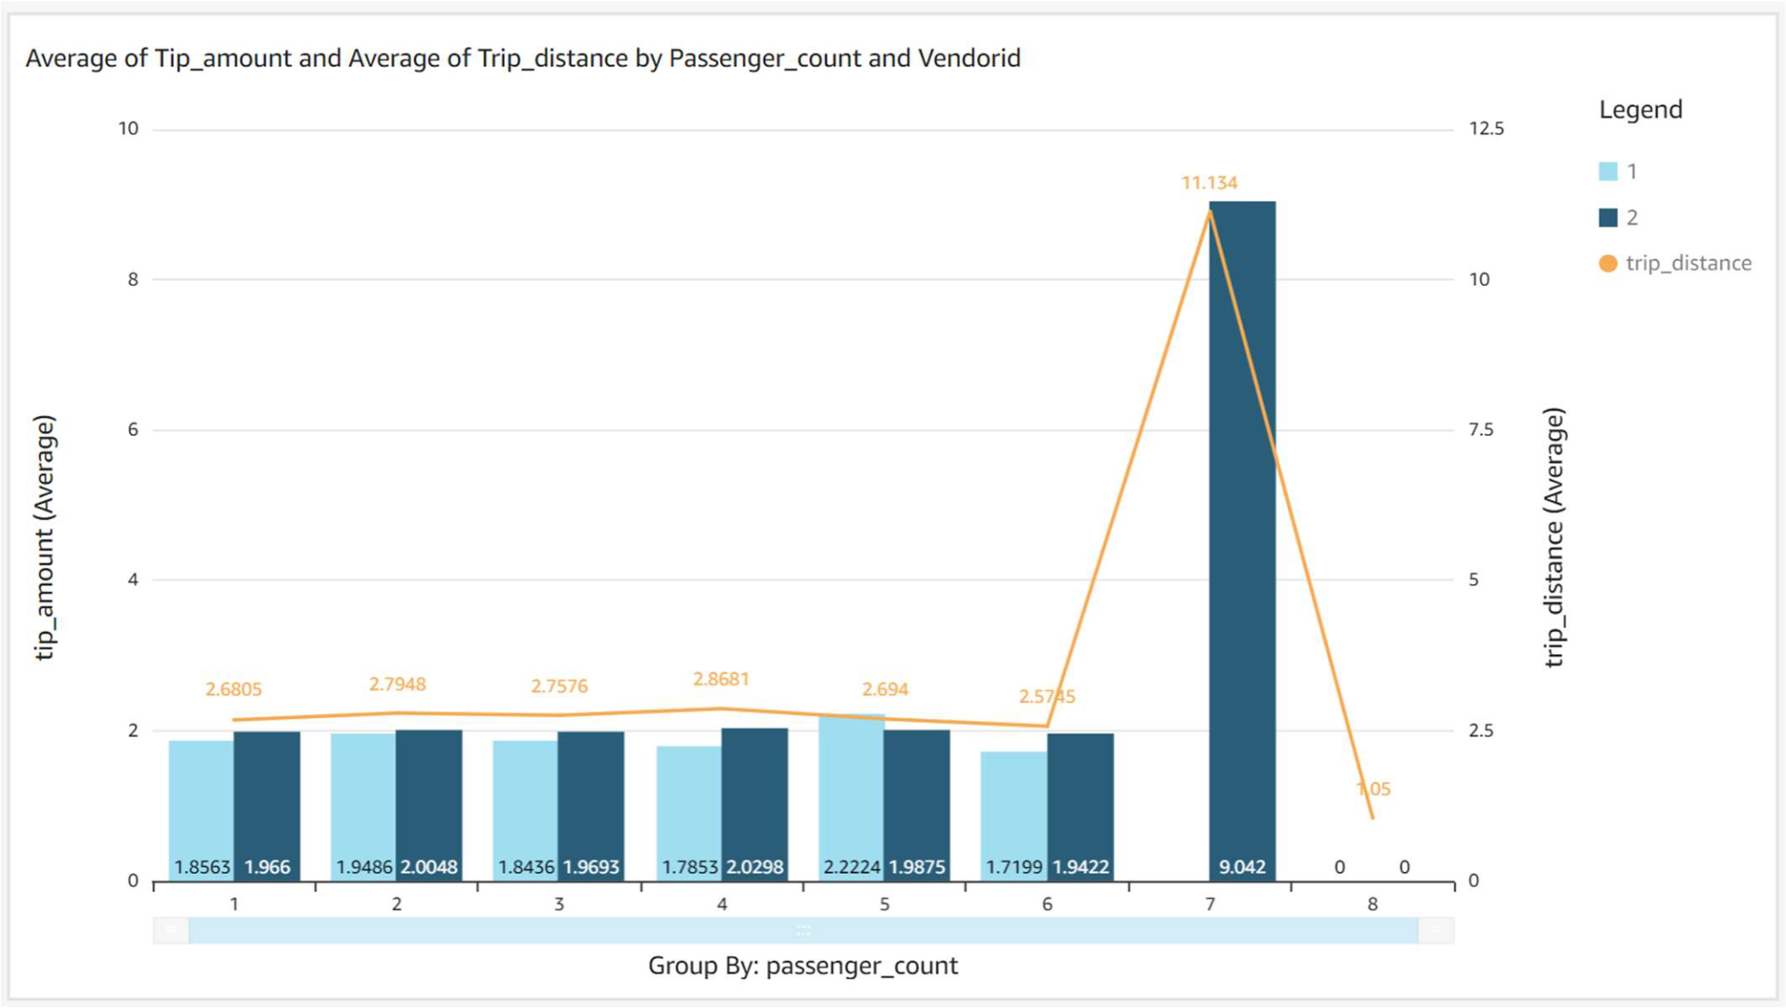
Data Analysis
Analysis 3:
This Clustered Bar Combo Chart gives information about average tip amounts given by passengers
traveling alone/traveling in a group of 2, 3, 4, 5, 6, 7, 8. The chart also groups the average tip amount
received by different vendors. The line chart represents the average trip distance buy these vendors.
From the analysis, it is observed that:
1. The maximum tip amount is given by passengers who are traveling in groups of 7.
2. Passengers in groups of 7 travel the longest distance.
3. Only vendor 2 has passengers who travel in group of 7.

Slide 11
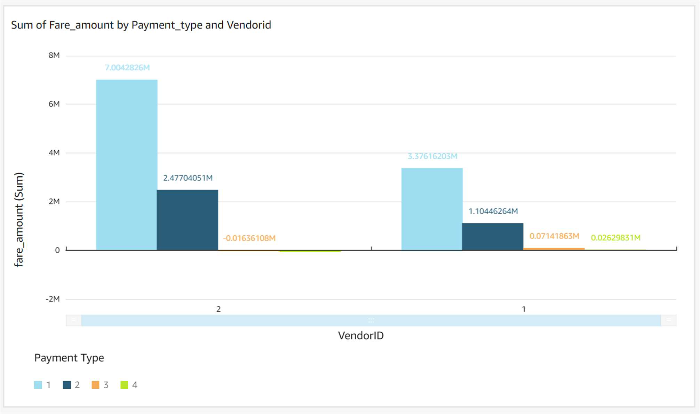
Data Analysis
Analysis 4:
This vertical bar chart shows the total fare amount by vendor and payment type.
1. In both the vendors, payment type 1 has highest share among the 4 payment types.
2. Vendor 2 collects more fare amount than vendor 1.

Slide 12
Machine Learning
Used Linear regression and Gradient Boost regression.
We built two regression model to predict the tip amount for eligible taxi trips. Model fit is evaluated using the train-test split method to randomly split sampled data into 80% training set and 20% testing set.
Initial feature selection was done by investigating the relationship plot to drop repetitive indicators to keep away from overfitting. Highlights like climate information that are uncorrelated with the reaction was overlooked as they were veiled the impact of different indicators. Additional feature selection was used to t-test.

Slide 13
​​
Evaluation and Optimization
Goodness-of-fit statistics
Model | Train Set RMSE | Test Set RMSE | Train set R² | Test Set R²
Baseline | 2.61 | 2.44 | 0 | 0
Linear Regression | 1.97 | 1.76 | 0.42 | 0.48
Gradient Regression | 1.84 | 1.73 | 0.5 | 0.49

Slide 14
​​
Evaluation and Optimization
Compared to the baseline, the final fitted linear model explained an additional 69% variance in tip amount; and scored approximately 2.0 for RMSE; Given that the average tip amount is around $2.59, most predictions are just $0.5 away from the actual tip amount. A more advanced gradient boost regression was also applied to predict the tip amount. Gradient boosting minimises the loss by iteratively modeling the residuals.

Slide 15
​​
Results
After the Data Analysis it is observed that Maximum fare amount was on Friday i.e $2.8 Million and the minimum was on Sunday i.e $1.95 Million. Passengers traveling alone contribute more to the total fare amount, and Friday is seen to have the highest collection. Passengers traveling in group of 2 contribute the second highest to the total fare amount. The maximum tip amount is given by passengers who are traveling in groups of 7. Passengers in groups of 7 travel the longest distance. Only vendor 2 has passengers who travel in group of 7.
The Machine learning algorithm of Linear Regression was also able to predict the approximate tip amount of $2 which is just $0.5 away from the real value.

Slide 16
Future Work and Comments
Q.1 What was unique about the data? Did you have to deal with imbalance? What data cleaning did you do? Outlier treatment? Imputation?
Ans.The data was detailed and had lost of information like fare amount , payment type, etc. which puts clear information. Although the data had lots of information we also had to remove null values and added one more column for the day by corresponding it with the date. The correlation between the data also showed that the columns were not related to each other as most values were around 0.16 value.
Q.2 Did you create any new additional features / variables? What was the process you used for evaluation? What was the best result? Ans.2 Ans. Yes, we had to add one more column of days to calculate the total amount of fare on each day by corresponding it with the date. With the help of this we were able to see that Friday had maximum fare compared to other days.

Slide 17
Future Work and Comments
Q.3 What was the process you used for evaluation? What was the best result?
Ans. We used Machine learning models Linear Regression and Gradient Boost Regression and compared it to baseline model. The linear regression was able to predict the tip amount of $2 which is just $0.5 away from the actual value of $2.5.
Q.4 What were the problems you faced? How did you solve them?
Ans. Although the data was detailed, It had to be pre-processed by removing null values and outliers. The data were also not correlated with each other.
Q.5 What future work would you like to do?
Ans. Since the data was from 2018 we would also like to add the data from covid19 and see the impact of covid19 on Taxis.

Slide 18
Future Work and Comments
Q.6 Instructions for individuals that may want to use your work ?
Ans. Since we have already cleaned the data. People can use it to focus more on applying more advanced ML models.

